Slide 1




Design of a Thermal Management System for a Lithium-ion Battery Pack
Mahmoud El-Soghayar
Sherif Abdelrahim
Qasim Mahmoud
Muhammad Essam
Amr Ahmed Al-Sayed
Ziad Muhammad

Slide 2




OVERVIEW
Heating Equations
INTRODUCTION
Cooling Equations
Why 18650 ?
Electrical equivalent
& Simulation

Slide 3



SECTION 1
INTRODUCTION

Slide 4
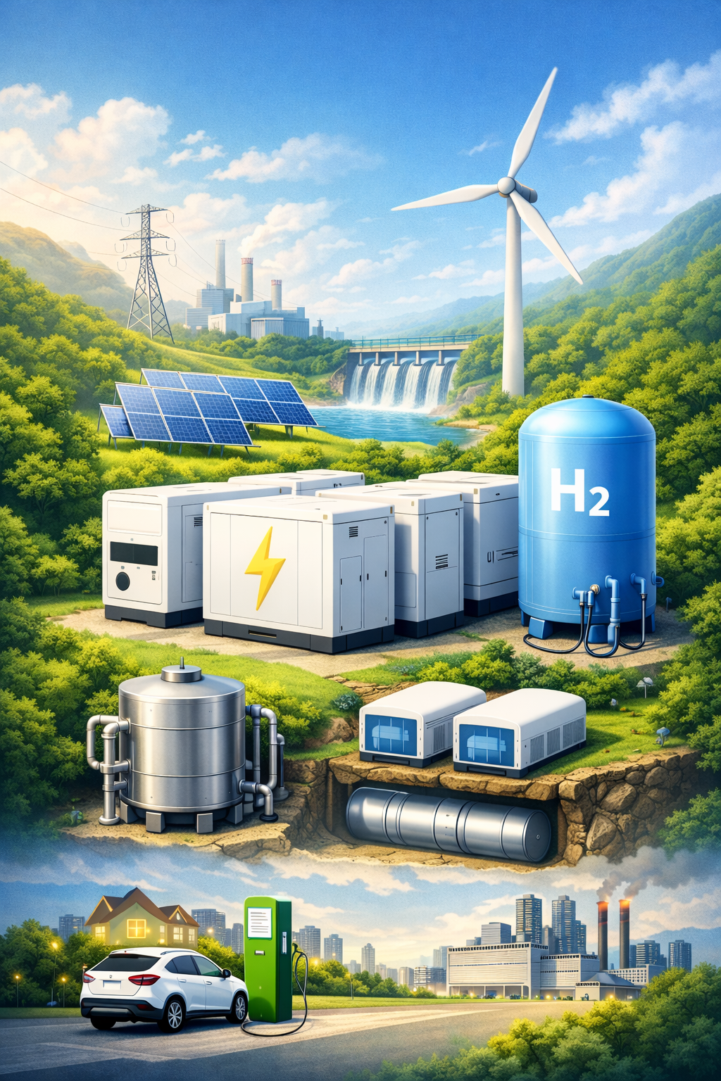



Energy Storage Systems (ESS) Overview
Storing energy during low demand → Releasing it during high demand
Key Drivers
Main Categories
01
Renewables: Bridging the gap for intermittent Solar/Wind.
01
Electrochemical: Lithium-ion, Flow Batteries.
02
Grid Stability: Instant frequency and voltage regulation.
02
Mechanical: Pumped Hydro, Flywheels.
03
Reliability: Emergency backup and peak-shaving.
Thermal: Molten Salt, Ice Storage.
03

Slide 5
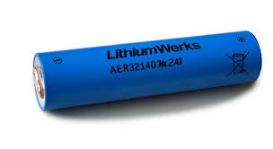
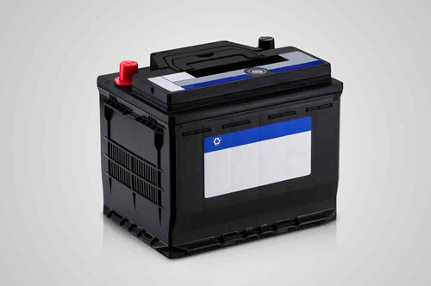

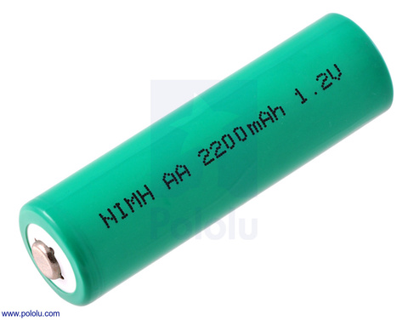
Types Of Batteries
1-Lead-Acid-
3-Li-ion
2-NimH
4Li-Po

Slide 6
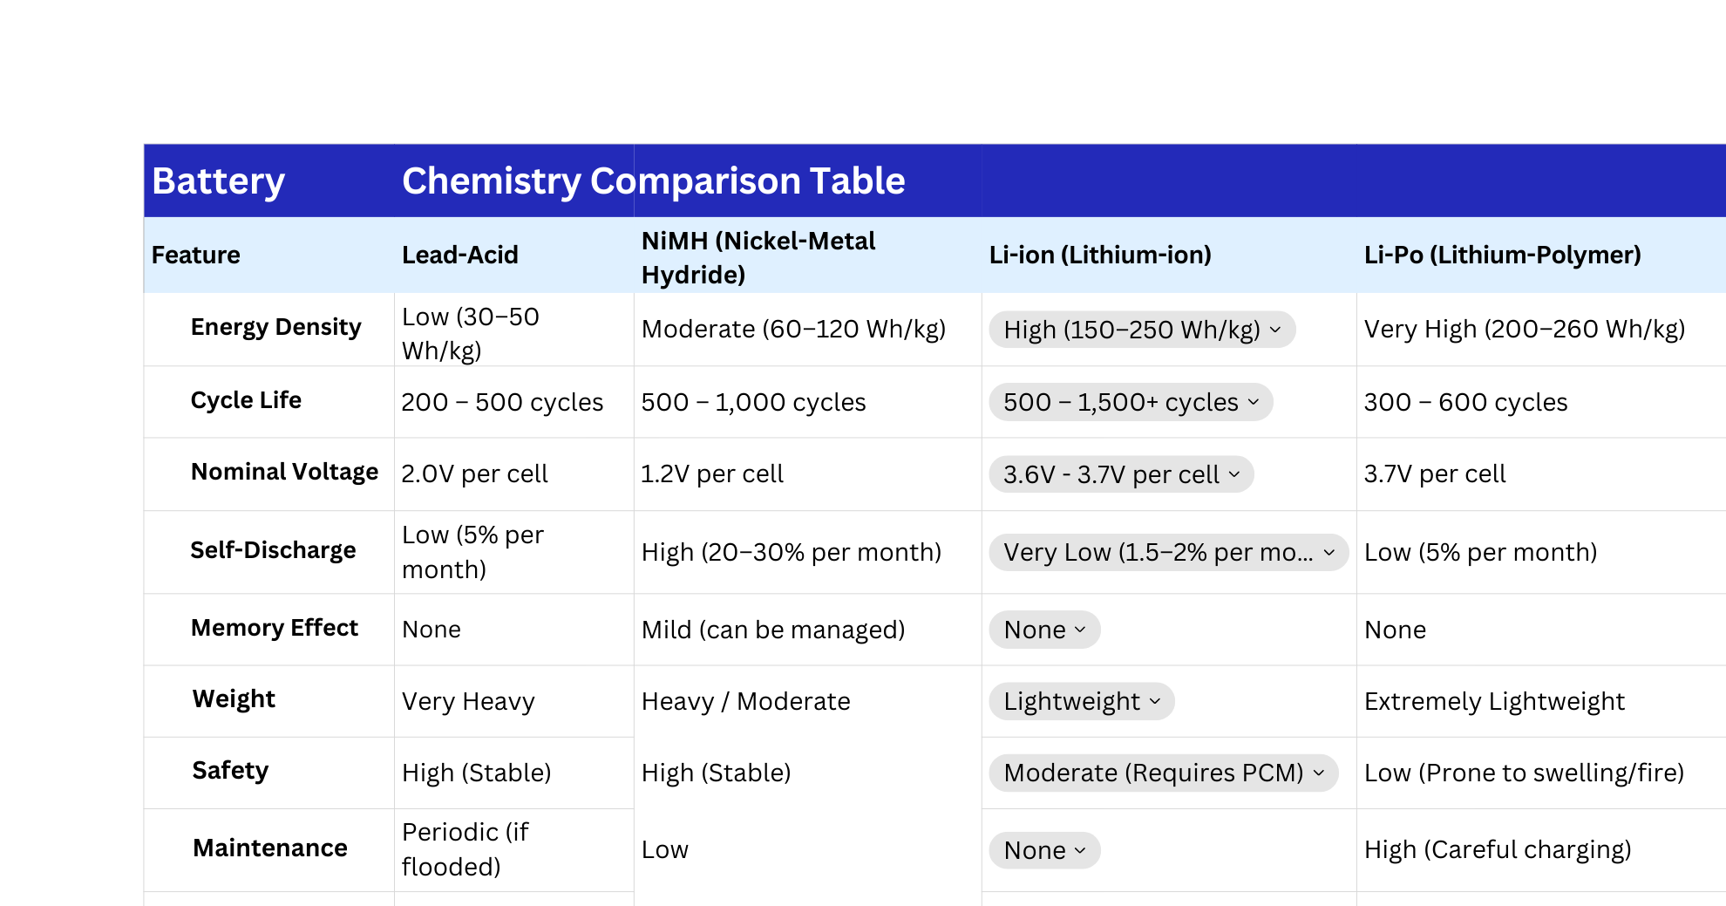

Slide 7
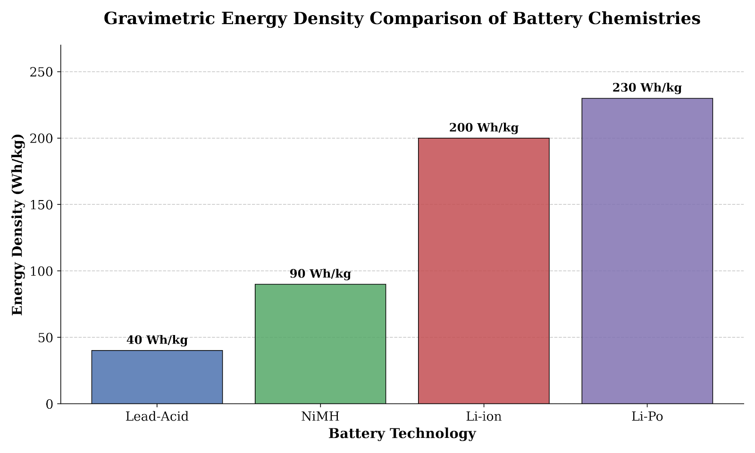

Slide 8
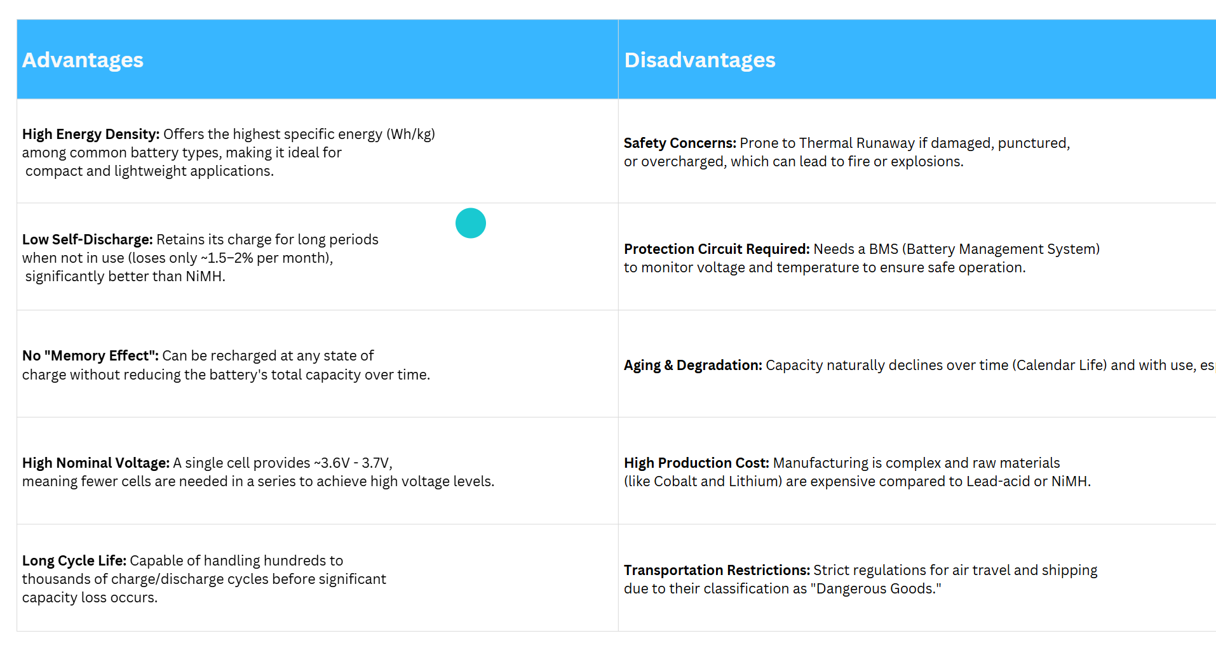

Slide 9

SECTION 2
WHY LI-ION
18650 BATTERY?

Slide 10

Why Lithium-Ion? – Key Selection Parameters
01
High Energy Density: Li-ion batteries offer superior energy-to-weight ratios (Wh/kg), essential for reducing the overall weight of the battery pack.
03
Market Availability: Mature supply chains ensuring a steady supply of cells for both prototyping and mass production.
02
Optimal Thermal Behavior: Balanced operating temperature range compared to other chemistries, though requiring active management.
04
Industry Adaptation: Widely adopted in consumer electronics and automotive sectors, providing a proven track record of reliability and safety.

Slide 11
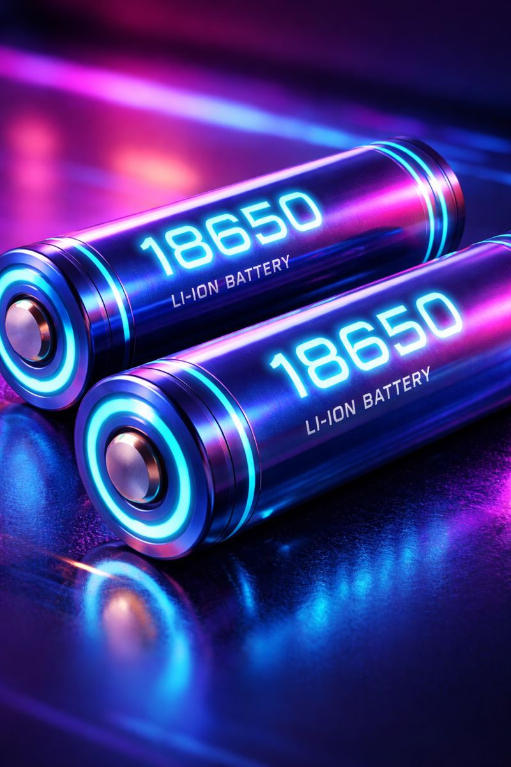
Why Lithium-Ion? – Key Selection Parameters
01
Standardized Geometry: The 18mm x 65mm cylindrical format is a global standard, allowing for modular design and easy replacement.
03
Rich Documentation: Availability of detailed Data Sheets (discharge curves, internal resistance, and thermal specs) facilitates precise engineering.
02
EV Industry Benchmark: Extensively used in electric vehicle (EV) battery packs (notably by Tesla) due to their efficiency in pack-level cooling.
04
Ease of Modeling: The cylindrical shape simplifies Mathematical and CFD (Computational Fluid Dynamics) modeling for thermal analysis.

Slide 12

TECHNICAL CHALLENGES & THERMAL CONSTRAINTS
HIGH C-RATE HEAT GENERATION
01
Rapid charging or discharging leads to significant Joule heating (P = I2R), potentially exceeding safe operating limits.
04
NON-UNIFORM TEMPERATURE DISTRIBUTION
02
The core of the cell stays hotter than the surface, creating internal thermal gradients that can lead to accelerated degradation.
05
THERMAL MANAGEMENT NECESSITY
03
High density in packs requires a robust Cooling System to prevent "Thermal Runaway" and ensure "Cell Balancing."
06

Slide 13
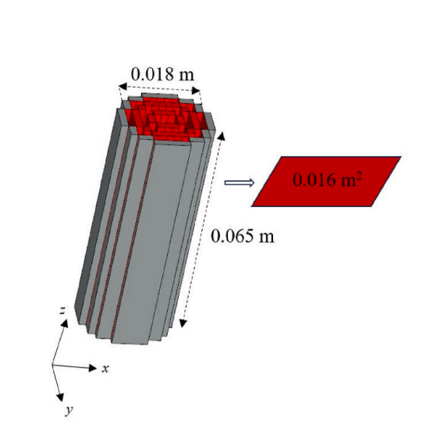
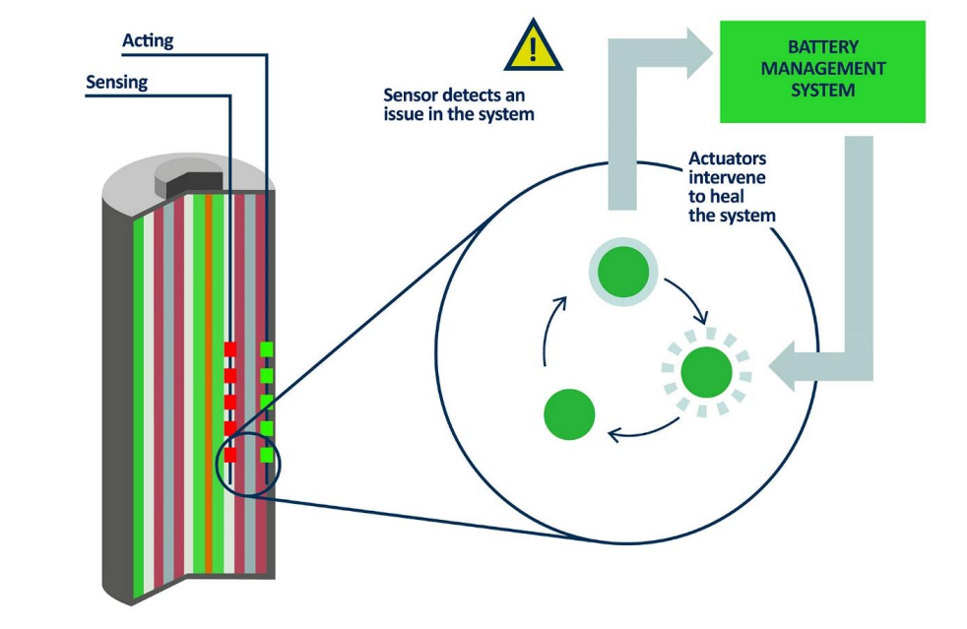
Modeling

Slide 14
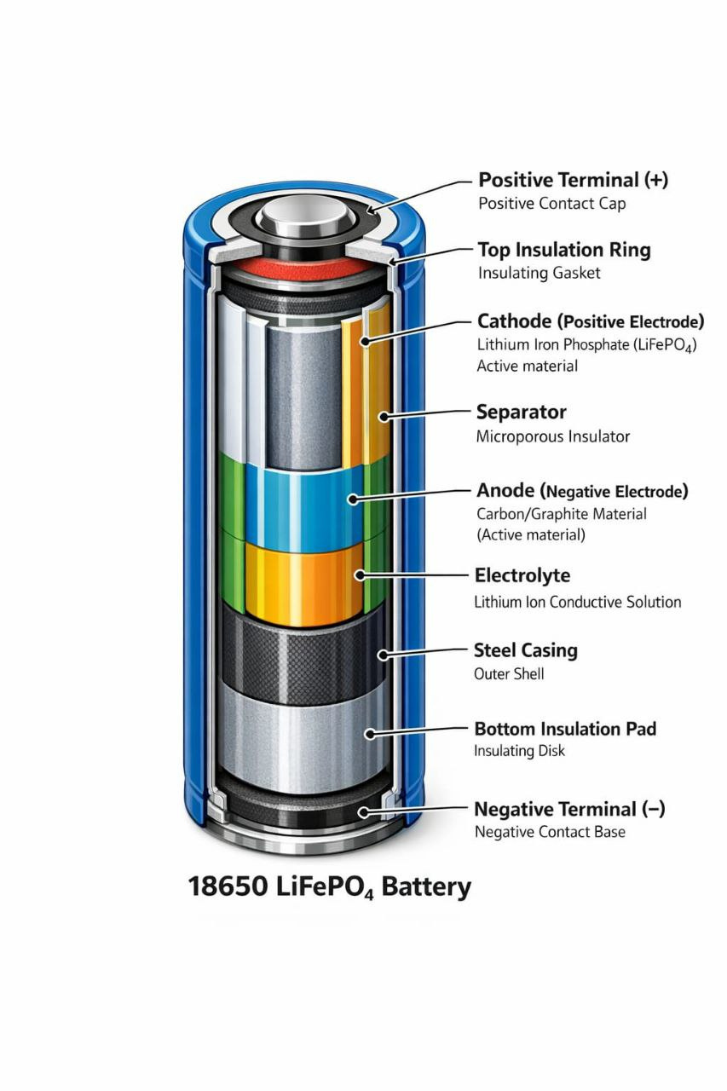
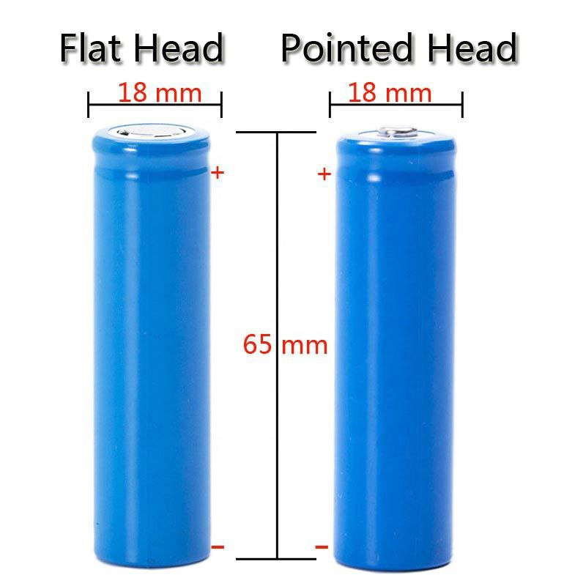

Slide 15

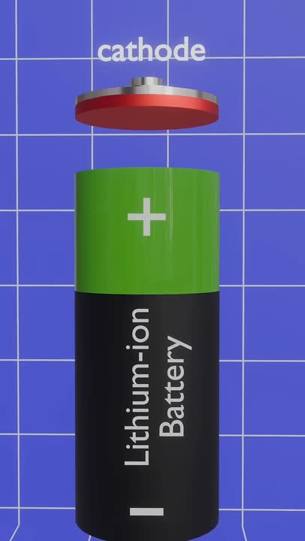

Slide 16


SECTION 3
HEATING EQUATIONS

Slide 17
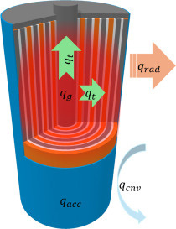
Internal Heat Sources in Li-ion Cells
Heat generation in a Lithium-ion battery during operation is a complex phenomenon arising from three primary sources:
01
Ohmic Heat (Joule Heating): Caused by the resistance of electrons flowing through the current collectors and tabs, and ions moving through the electrolyte and separator.
02
Reaction Heat (Activation Overpotential): Energy lost due to the electrochemical reactions occurring at the interface between the electrodes and the electrolyte.
03
Entropic Heat (Reversible Heat): Heat associated with the change in entropy during the insertion/extraction of Lithium ions into the electrode lattice. This can be exothermic or endothermic depending on the state of charge (SoC).

Slide 18
Mathematical Modeling of Heat Rate
The total heat generated per unit volume (Qgen) is typically modeled using the simplified Bernardi equation, which is widely accepted in battery thermal management:
Q_{gen}​=I [ (V_{oc}​−V) − (T dV_{oc}/dT​) ​]
Where:
I(Voc - V) : Represents the Irreversible Heat (Ohmic & Activation losses). Voc is open Circuit Voltage ; V is the Operating Voltage
I(T dVoc / dT) : Represents Reversible Heat (Entropic Heat).
dVoc/dT: The entropy coefficient, indicating how Voc changes with temperature.

Slide 19
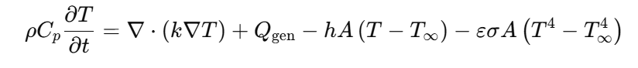
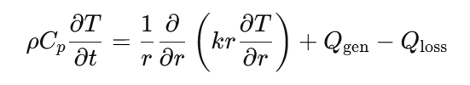
The Governing Thermal Equation
To design an effective cooling system, we must apply the law of conservation of energy. The energy balance for a single 18650 cell is expressed as:
1
ρC_{p} (∂T/ ​∂t) ​=∇⋅(k∇T)+Q_{gen}​−Q_{conv}​−Q_{rad}​
1- Q_{conv} = hA(T−T∞​)
2- Q_{rad} = εσA(T⁴−T∞⁴​)
2
3
cylindrical 18650 cell

Slide 20
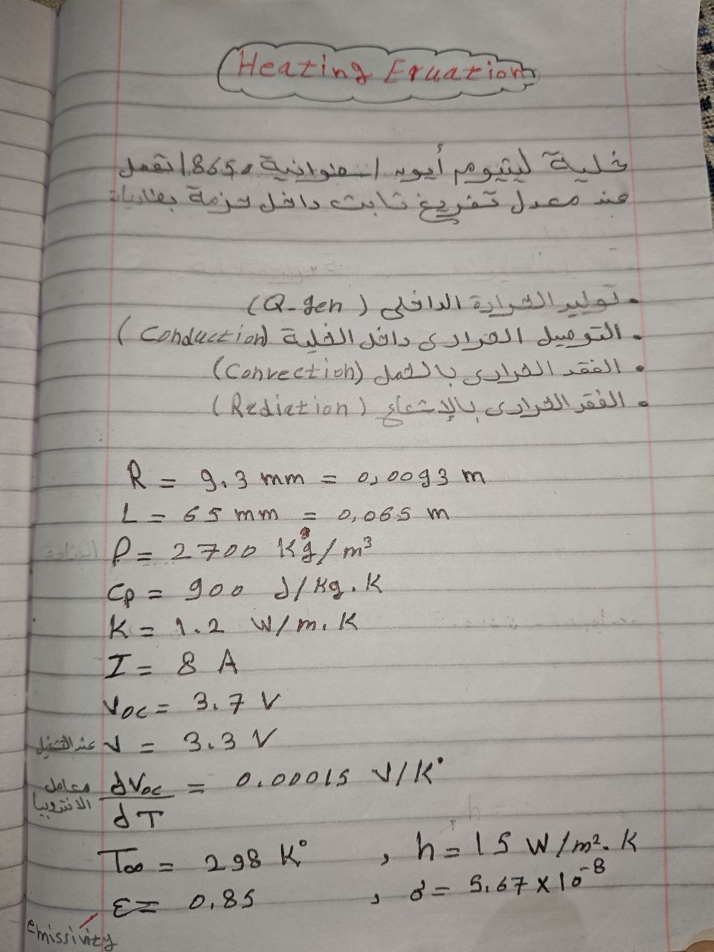
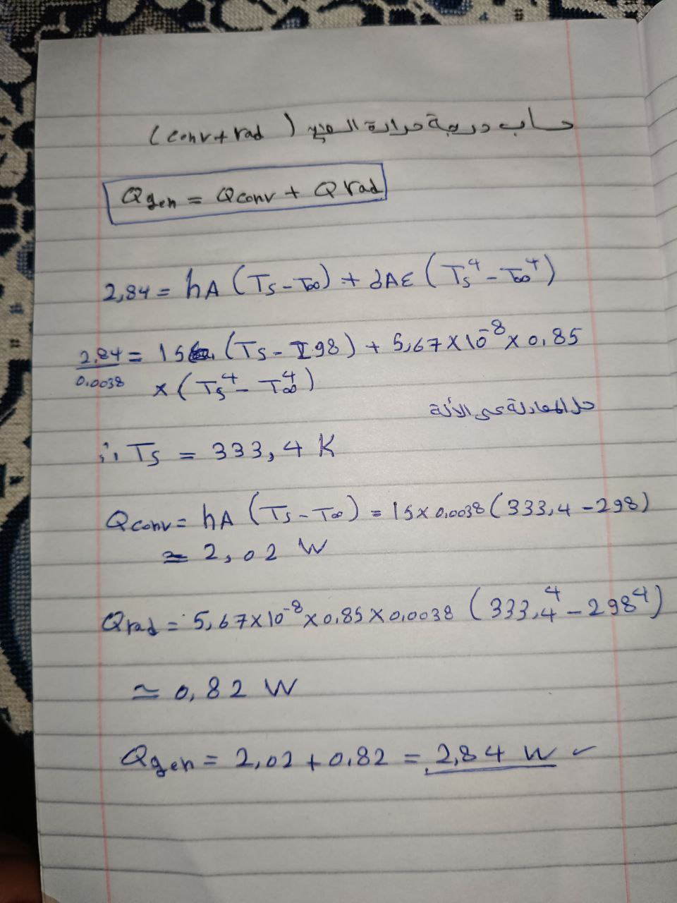

Slide 21
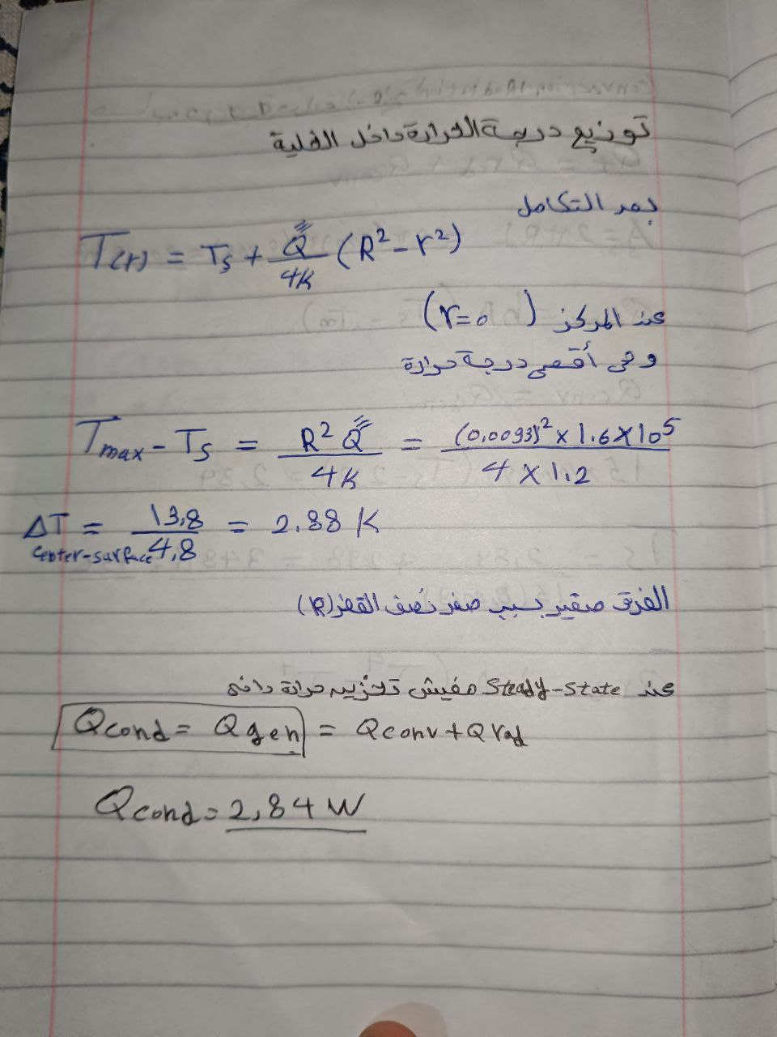
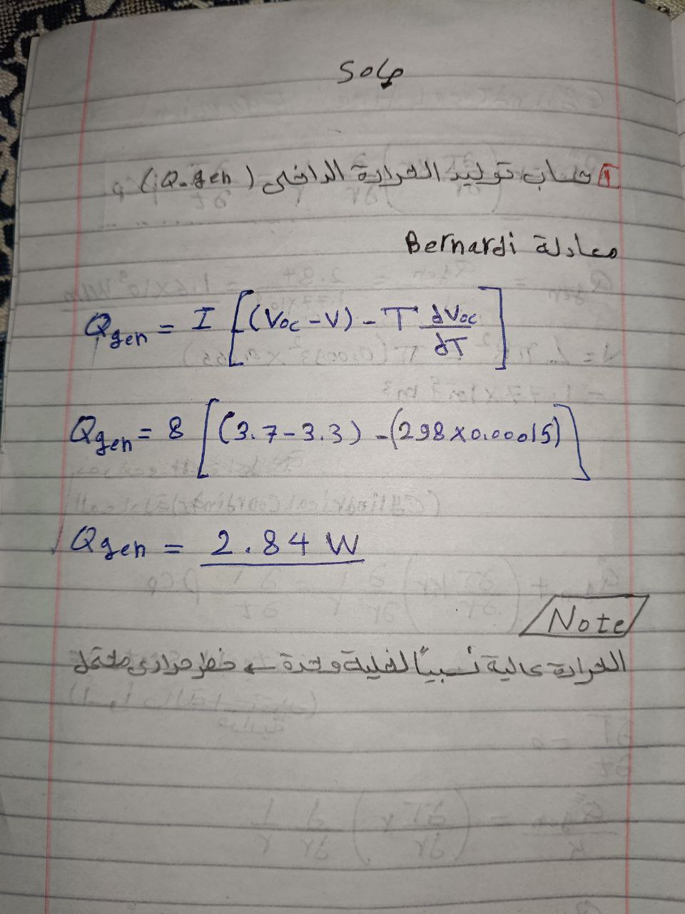

Slide 22
SECTION 4
COOLING
EQUATIONS

Slide 23
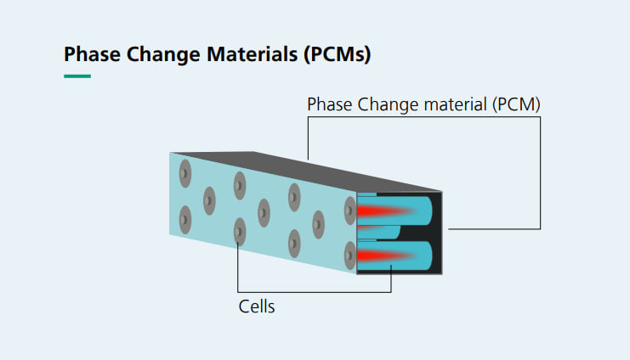
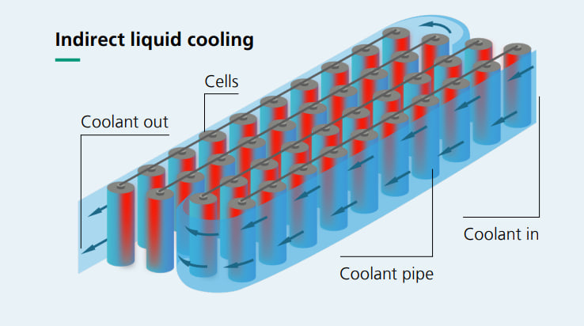
Battery Thermal Management Systems (BTMS) – Strategies
Air Cooling:
Pros: Simple, lightweight, and low cost.
Cons: Low heat transfer coefficient; struggles with high C-rates and large packs.
Phase Change Materials (PCM):
Pros: Passive cooling (no power needed); excellent at absorbing peak heat (Latent Heat).
Cons: Adds weight; low thermal conductivity (often needs fins or metal foam).
Liquid Cooling:
Pros: High thermal conductivity and heat capacity; very compact and efficient.
Cons: Complex design (pumps, seals); risk of leakage; higher cost.

Slide 24
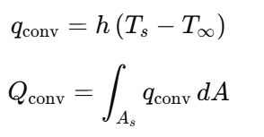
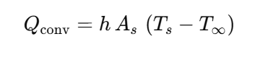
Convection Cooling Equation
The heat removed from the cell surface to the cooling medium is governed by Newton’s Law of Cooling:
where:
h: Convective Heat Transfer Coefficient (W/m2.K) . This value depends on the fluid velocity and properties.
As: Surface area of the 18650 cell (Cylindrical surface).
Ts: Temperature of the cell surface.
T∞: Temperature of the cooling fluid (Coolant/Air) at the inlet.

Slide 25
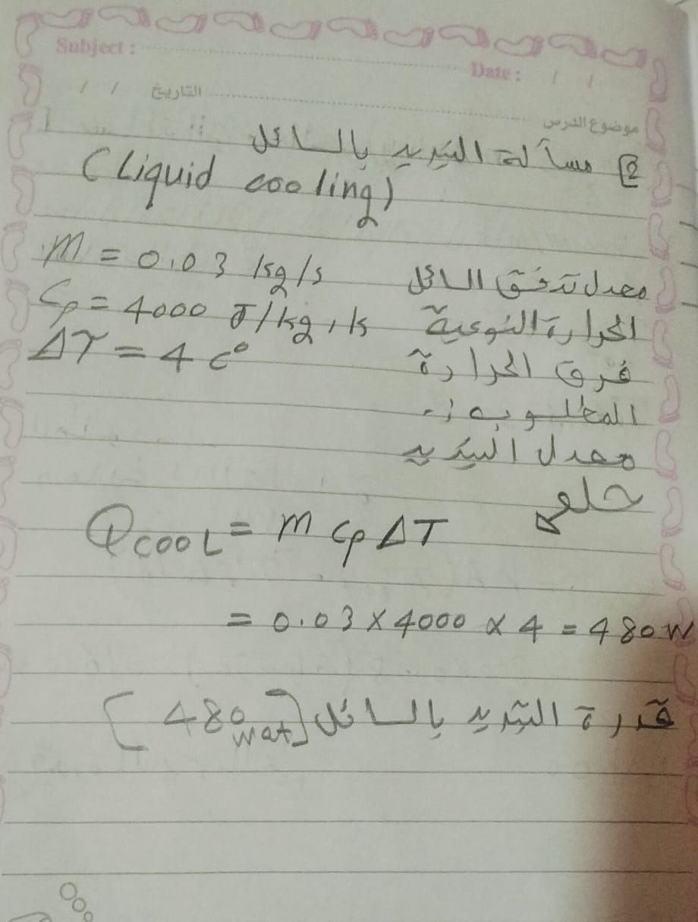
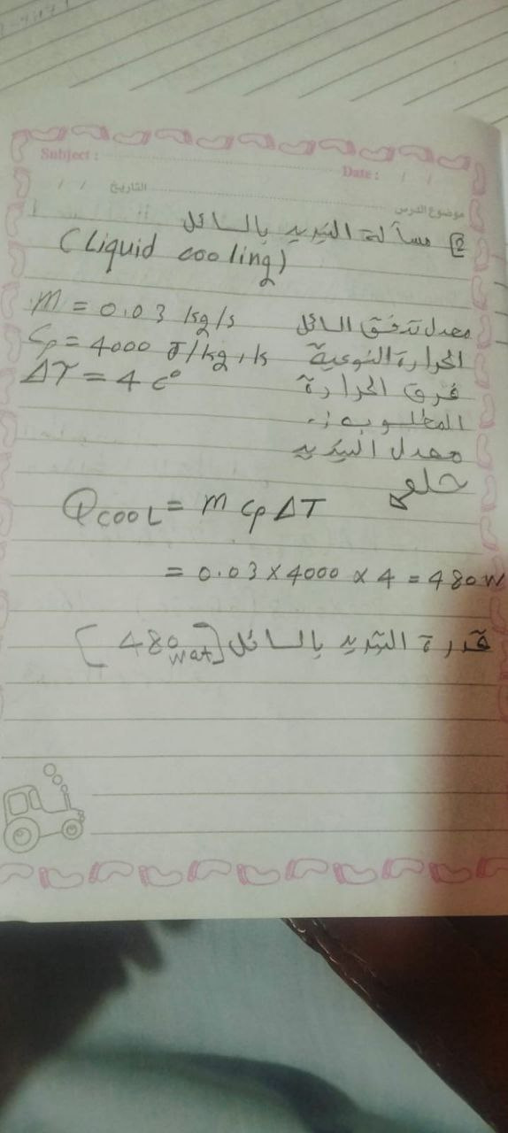

Slide 26
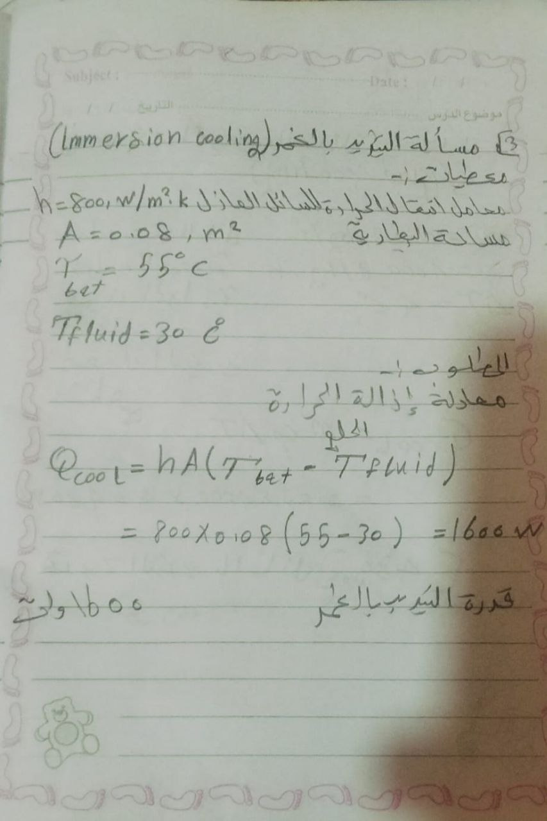
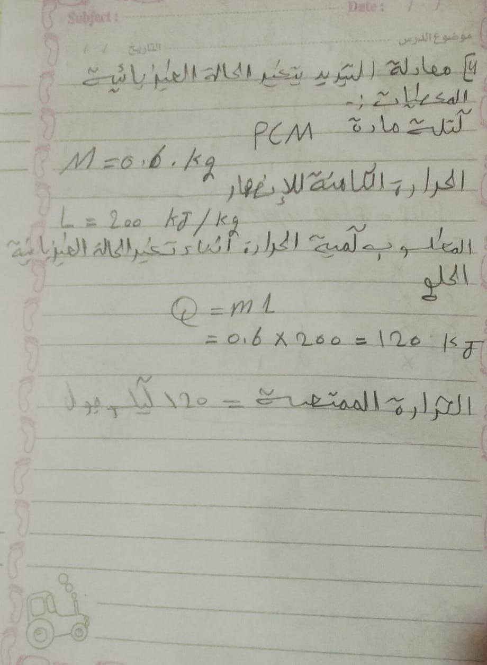

Slide 27
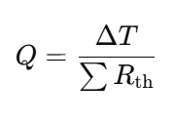
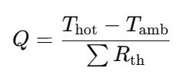
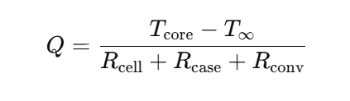
Thermal Resistance Model
To simplify the heat path from the battery core to the coolant, we use the electrical analogy (Ohm’s Law):

Slide 28
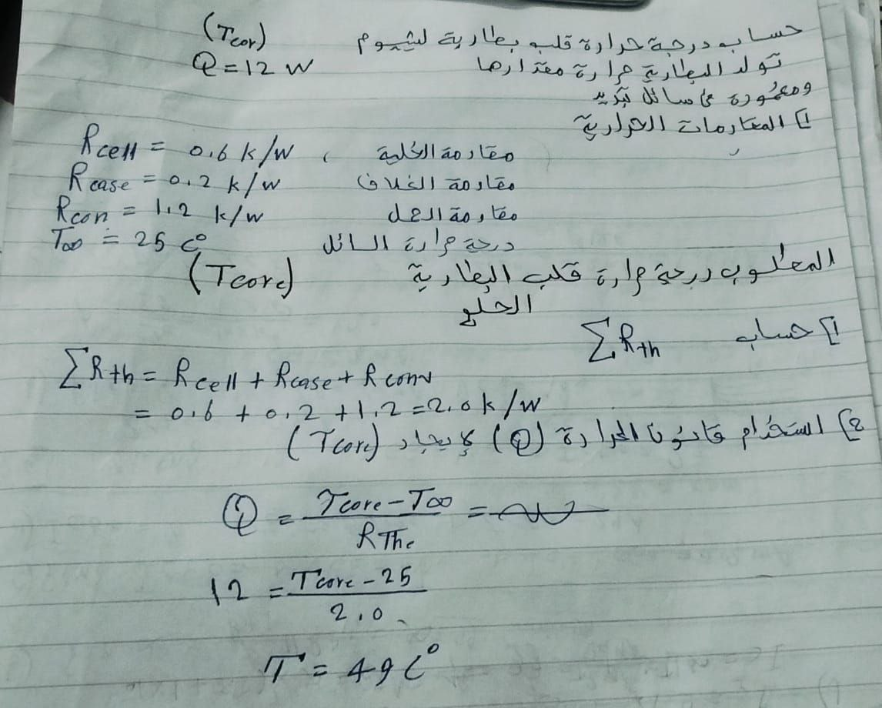

Slide 29
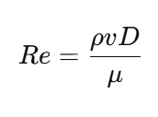
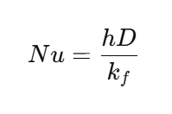
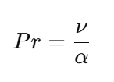
Dimensionless Numbers
Reynolds Number
Nusselt Number
Prandtl Number

Slide 30
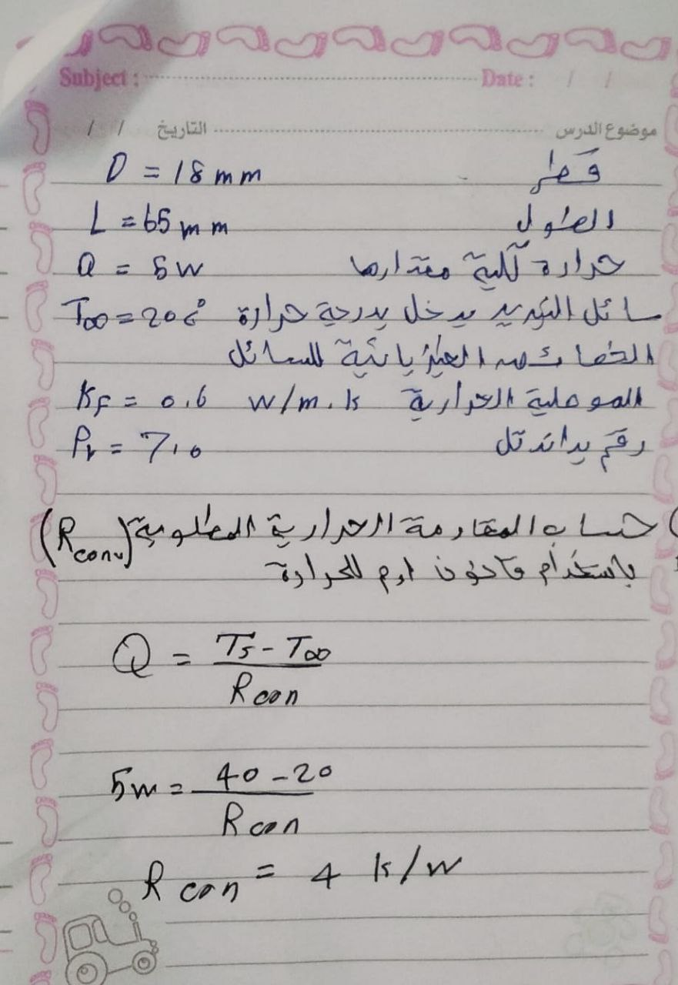
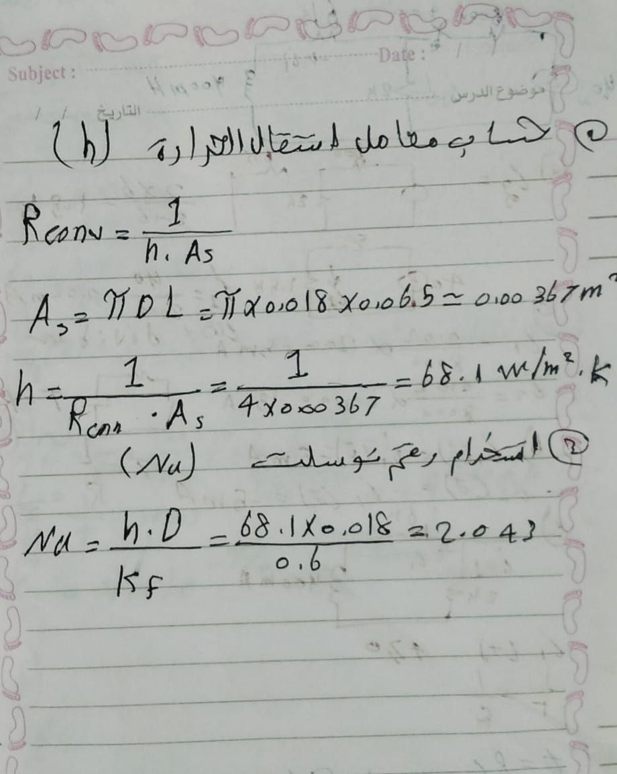

Slide 31

SECTION 5
ELECTRICAL

Slide 32
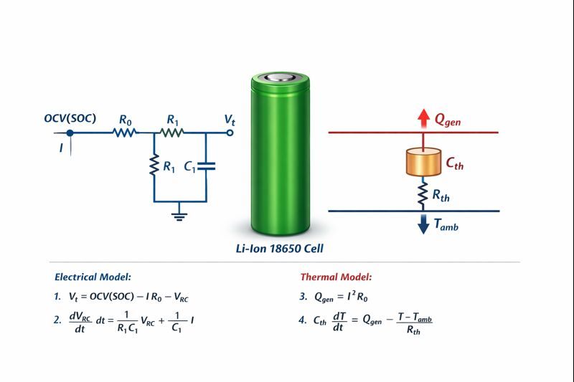
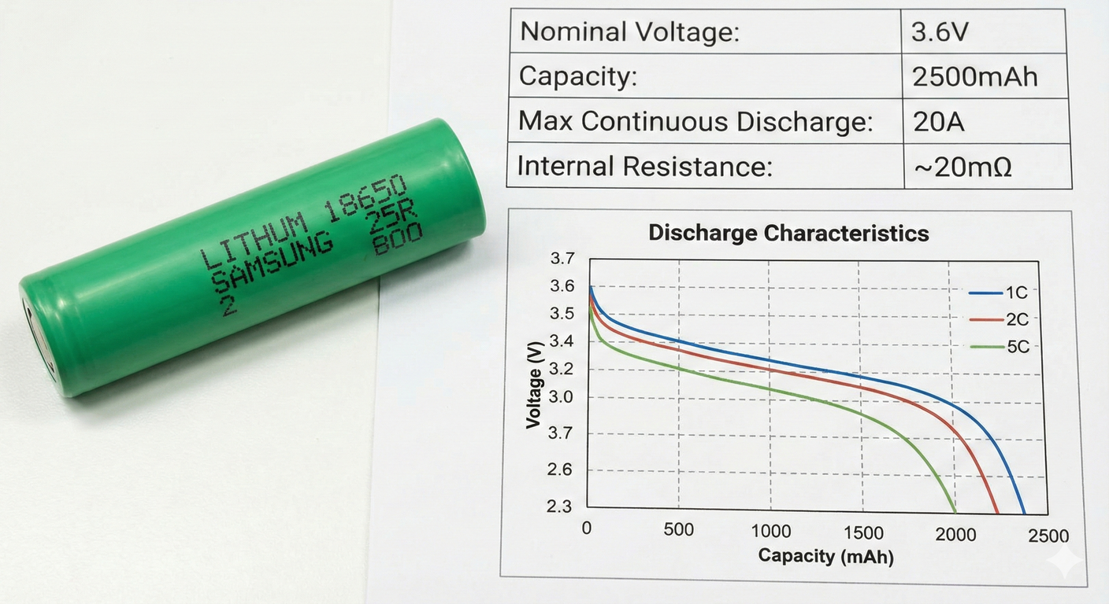
Electrical Characteristics of 18650 Cells
To accurately model the heat generation, we must define the electrical boundaries of the chosen 18650 cell (e.g., Samsung 25R or LG HG2):
Nominal Voltage: 3.6V - 3.7V
Capacity (Ah): Typically 2500mAh to 3500mAh.
Maximum Continuous Discharge Current: Essential for calculating peak Qgen . (e.g., 20A).
Internal Resistance (Rint): The primary driver of Ohmic heating. Usually ranges from 15mΩ to 50 mΩ.
Charge/Discharge Cut-off Voltages: 4.2V (Upper) and 2.5V(Lower).

Slide 33
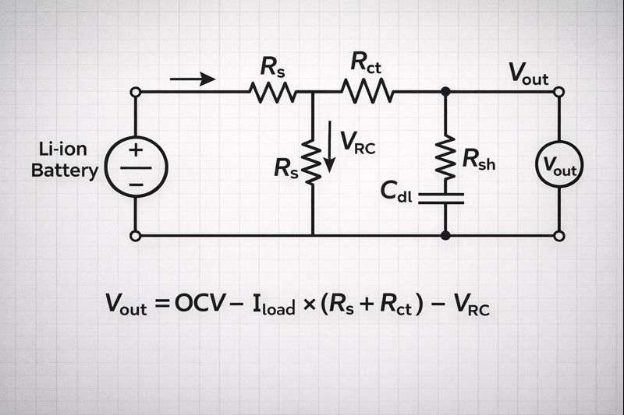
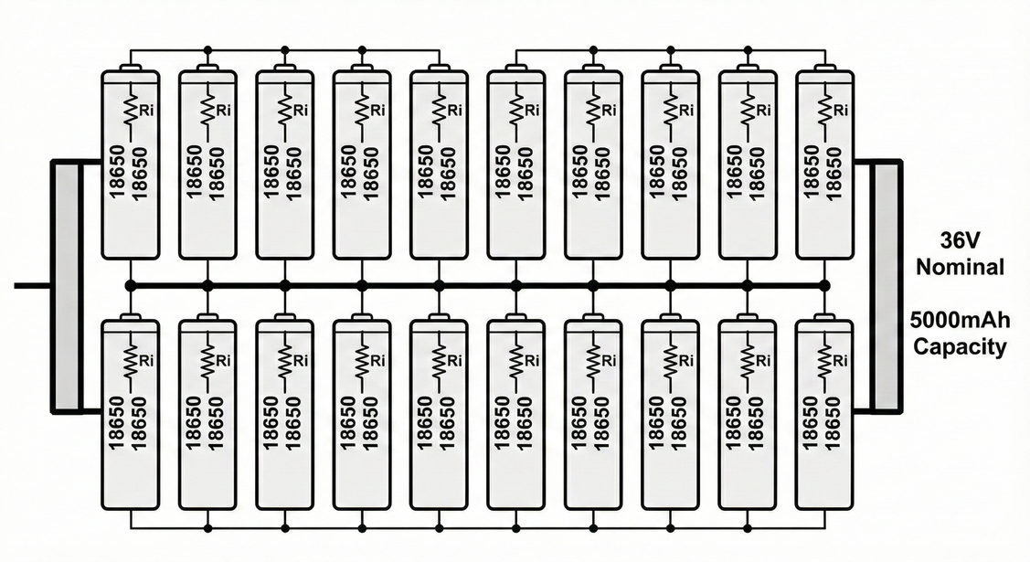
Battery Pack Configuration (S/P)
The electrical arrangement directly dictates the thermal load distribution:
Series Configuration (s): Increases voltage (V_{total} = n x V_{cell}). The same current flows through all cells, meaning uniform Ohmic heating if R_{int} is matched.
Parallel Configuration (p): Increases capacity and current capability. Total current is split (Icell = Itotal/ p).
Thermal Impact: High current in parallel busbars can create "Hot Spots."
Mismatched internal resistance in parallel strings leads to "Current Imbalance," where one cell works harder and gets hotter than others.

Slide 34
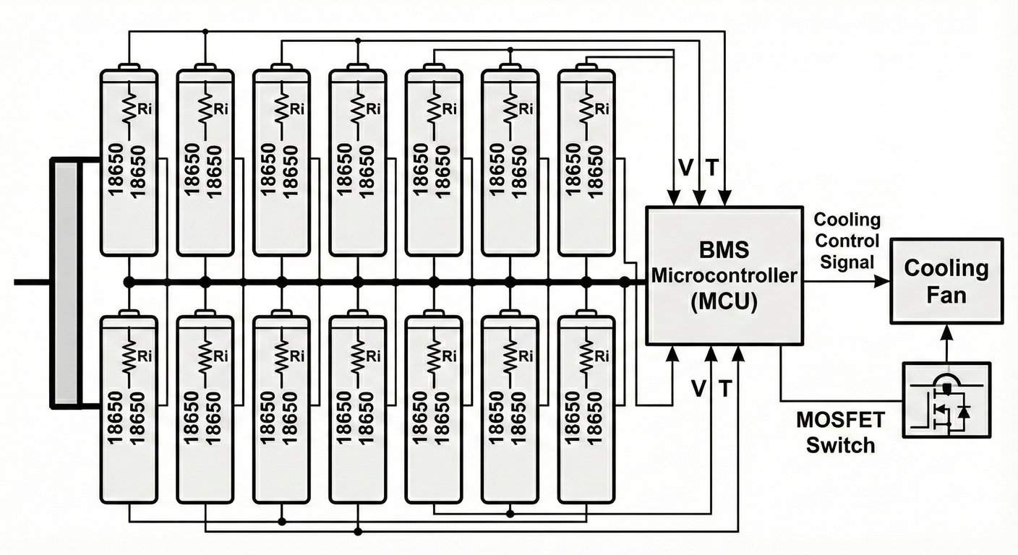
Battery Management System (BMS)
The BMS is the interface between the electrical state and the thermal management system:
Voltage Monitoring: Ensuring no cell exceeds 4.2V (preventing overcharge-induced heating).
Current Sensing: Monitoring for over-current scenarios that cause rapid temperature spikes.
Cell Balancing: Maintaining equal State of Charge (SoC) across cells to prevent localized overheating.
Thermal Interlock: The BMS can trigger the cooling system or "Derate" (limit) the power output if temperatures exceed 45℃.

Slide 35

Electrical Protection & Sensing
Thermistor Placement (NTC/PTC): Strategic placement of sensors to capture the "hottest cell" in the pack.
Fusing Strategy: Individual cell fuses to prevent a single internal short circuit from causing a pack-wide thermal runaway.
Insulation Monitoring: Ensuring high-voltage (HV) components are electrically isolated from the metallic cooling plates/liquid.
State of Health (SoH) Estimation: Tracking how electrical degradation increases thermal output over the battery's lifespan.

Slide 36

SECTION 6
SIMULATION

Slide 37
Mathematical Modeling of 18650 Thermal Dynamics
Objective: To predict the thermal behavior of a Panasonic NCR18650B cell under various load conditions.
Model Parameters:
Mass (m): 0.0465 kg | Specific Heat (Cp): 950 J/kg.
Internal Resistance (R_{int}): 0.045 Ω (The primary source of Ohmic heating).
Convective Environment: h = 15 W/m2.K (Simulating forced air cooling).
Thermal Time Constant (τ): Calculated as τ = (m.Cp ) / (h.A) ≅ 1063 S
This defines how fast the cell reaches steady-state temperature

Slide 38
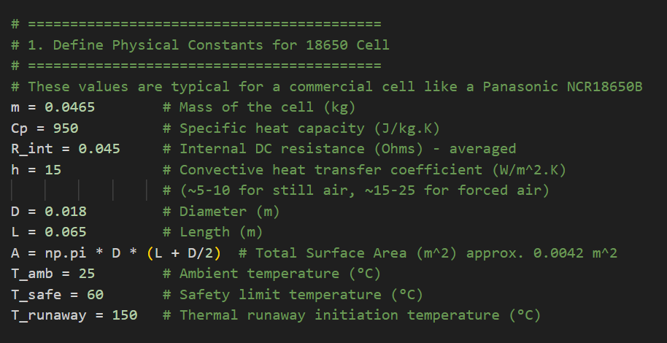
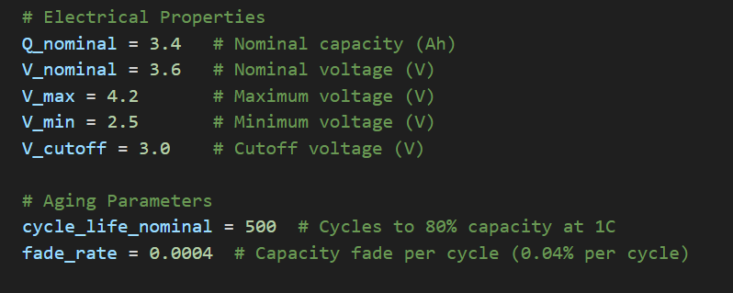
Initial Values (Physical Constants For 18650 Cell):

Slide 39
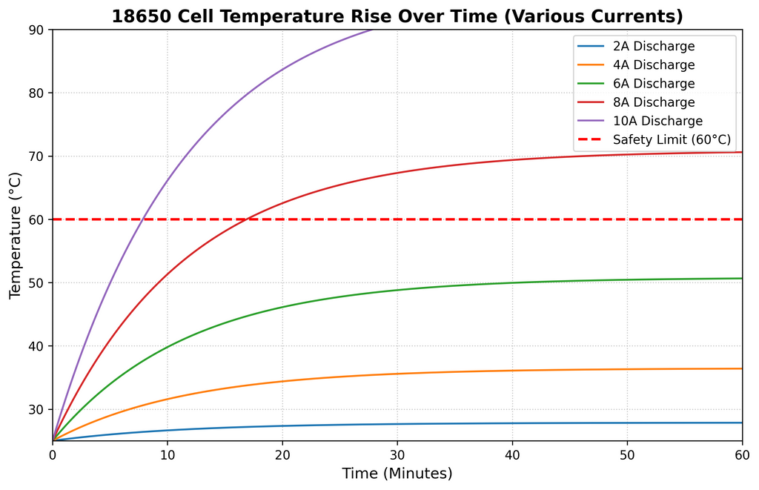
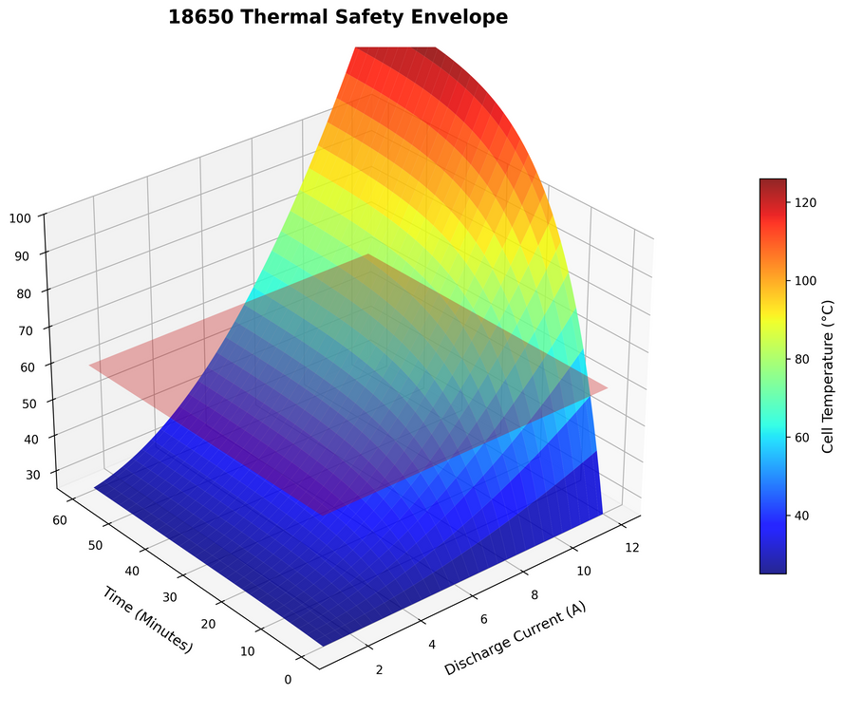
Temperature Evolution & Safety Boundaries
2D Temporal Response:
At currents > 6A, the cell exceeds the 60 ℃ safety limit within 20 minutes.
The curves follow an exponential rise: T(t) = Tamb + ΔTss (1-e(-t/τ)).
3D Thermal Envelope:
Visualizes the "Danger Zone" where Current and Time intersect.
Critical Observation: Sustained high-current discharge (> 8A) without active cooling leads to rapid thermal limit violation.

Slide 40

State of Charge (SOC) and Terminal Voltage Response
Discharge Characteristics:
Voltage drop is dominated by
Higher discharge rates (C-rates) significantly reduce the usable capacity.
Thermal-Electrical Coupling:
As SOC decreases, the internal resistance typically increases, further accelerating heat generation (I2R).
Thermal-Electrical Coupling:
As SOC decreases, the internal resistance typically increases, further accelerating heat generation (I2R).

Slide 41
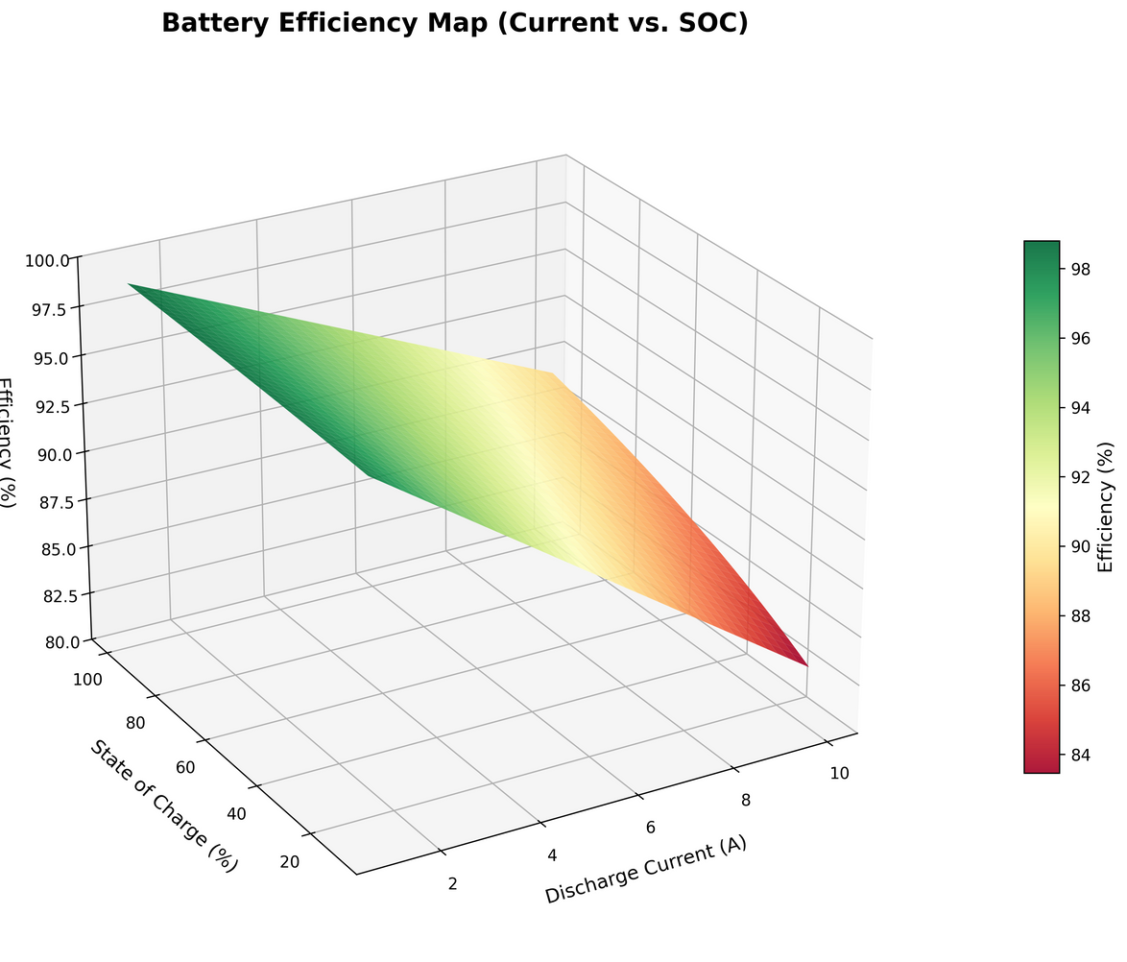
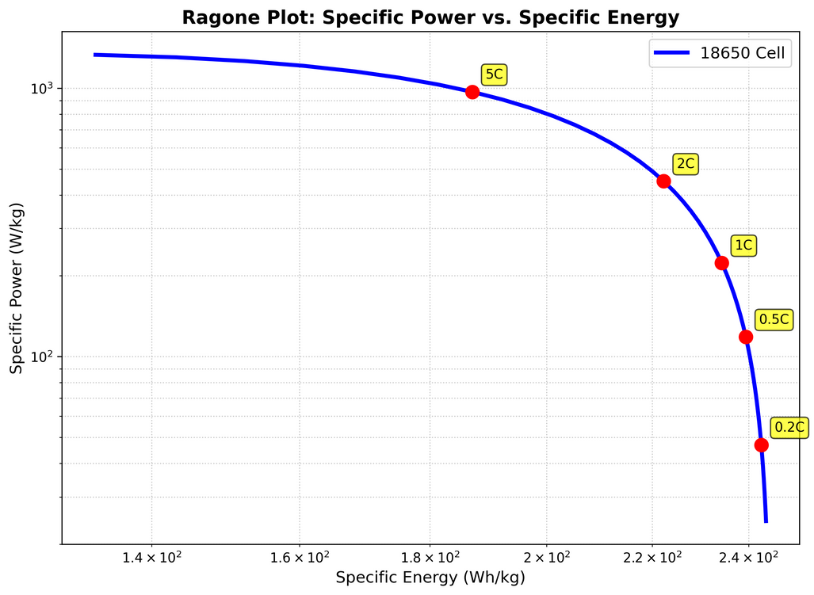
Ragone Plot and System Efficiency Map
Ragone Analysis:
Demonstrates the trade-off between Specific Power (W/kg) and Specific Energy (Wh/kg).
Increased power demands lead to lower delivered energy due to thermal losses.
3D Efficiency Map:
Peak Efficiency: Located at low currents and high SOC (> 95%).
Efficiency Degradation: Efficiency drops below 85% during high-current bursts, as more energy is converted to waste heat rather than electrical work.

Slide 42
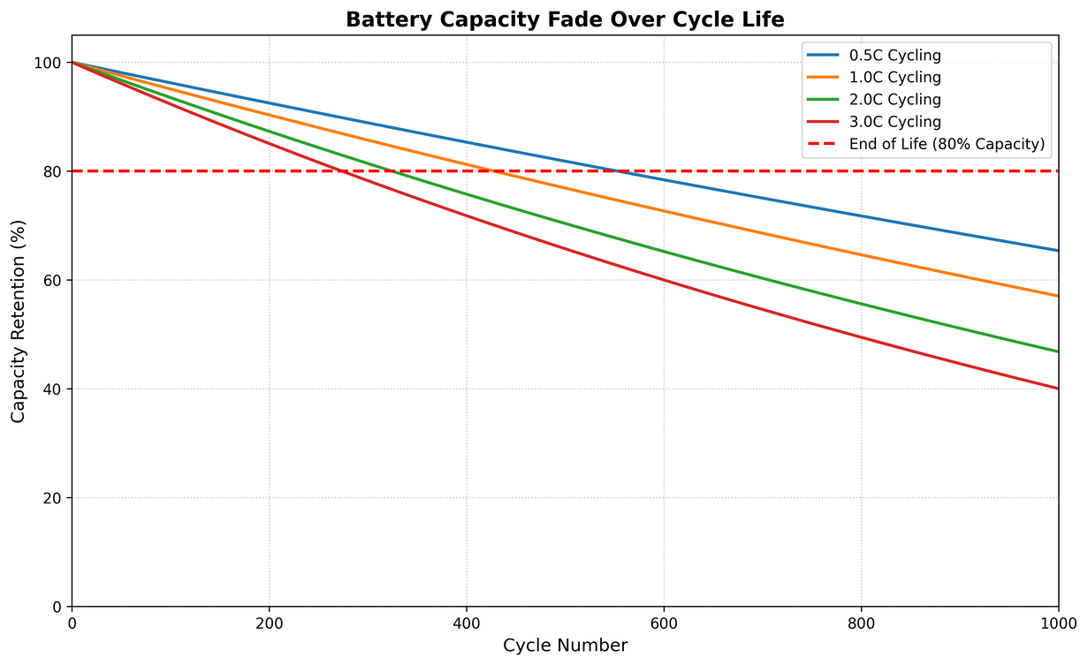
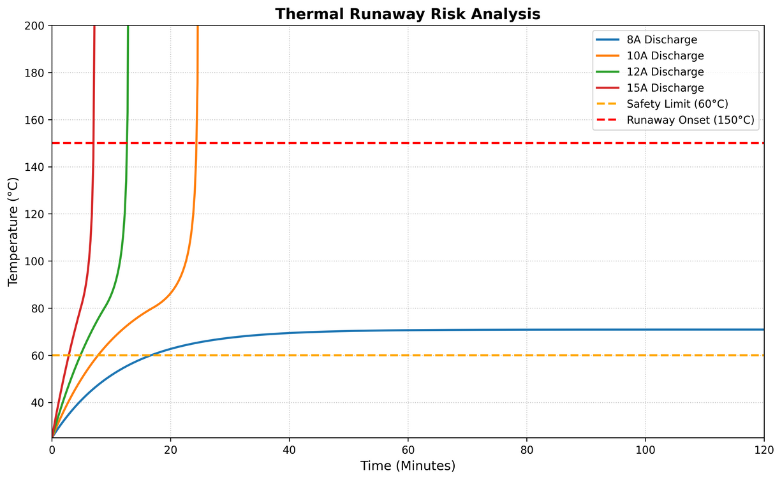
Thermal Runaway Risk and Capacity Fade
Thermal Runaway Analysis:
Simulates the "Self-Heating" acceleration above 80℃.
At 12A-15A, the cell reaches the Runaway Onset (150℃) rapidly, causing catastrophic failure.
Aging & Cycle Life:
Models capacity loss over 1000 cycles.
High-temperature operation significantly accelerates the Fade Rate, shortening the battery's lifespan to less than 500 cycles if not cooled properly.

Slide 43

Non-Uniform Temperature Profiling in 4x5 Arrays
The "Core" Effect:
Interior cells in a pack exhibit higher temperatures compared to peripheral cells.
Cause: Reduced convective surface exposure and heat radiation from neighboring cells.
Thermal Imbalance:
A temperature delta (ΔT) of > 5℃ across the pack leads to mismatched aging and electrical imbalance.
Design Conclusion: This confirms the necessity of Active Liquid Cooling or PCM to ensure pack-wide thermal uniformity.

Slide 44


Thank You

